Slide 1

Titanic Data Analysis
Presented by : Rana Ahmed Elmaghraby

Slide 2

Introduction
he Titanic dataset contains information about the passengers on board the Titanic ship that sank in 1912. It includes details such as age, gender, passenger class, and whether the passenger survived or not.
The goal of this analysis is to explore the data and uncover insights about the factors that influenced survival rates. By using data visualization and statistical methods, we aim to better understand patterns in the data and highlight key trends

Slide 3
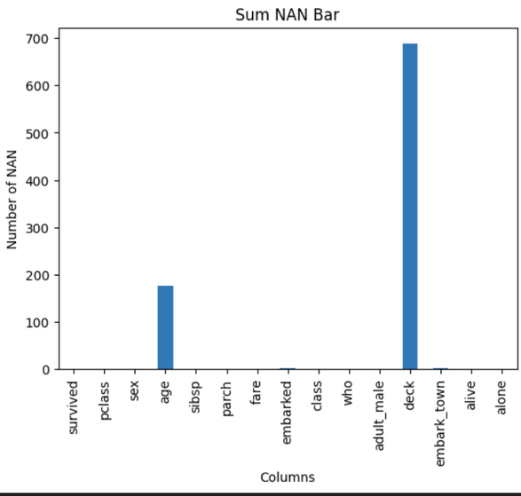
Data Overview
The Titanic dataset contains information about 891 passengers, with the following key features:
survived: Whether the passenger survived (0 = No, 1 = Yes)
pclass: Passenger class (1 = 1st, 2 = 2nd, 3 = 3rd)
sex: Gender of the passenger
age: Age of the passenger (some values are missing)
sibsp: Number of siblings/spouses aboard
parch: Number of parents/children aboard
fare: Ticket fare paid
embarked: Port of embarkation (some missing values)
Additional features such as deck, alive, and alone
Note: Some columns have missing data, especially age and deck, which will require cleaning or imputation.

Slide 4
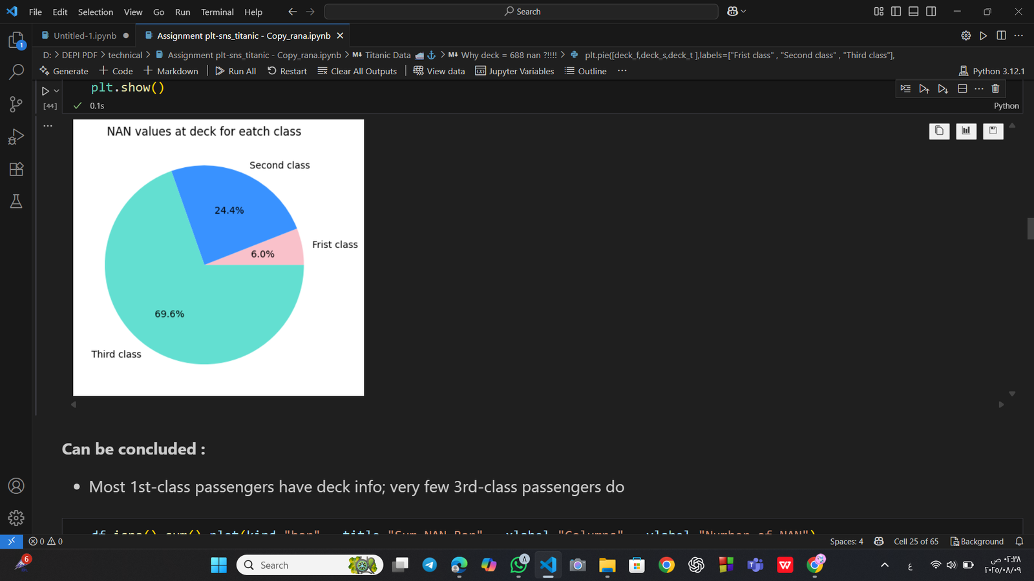
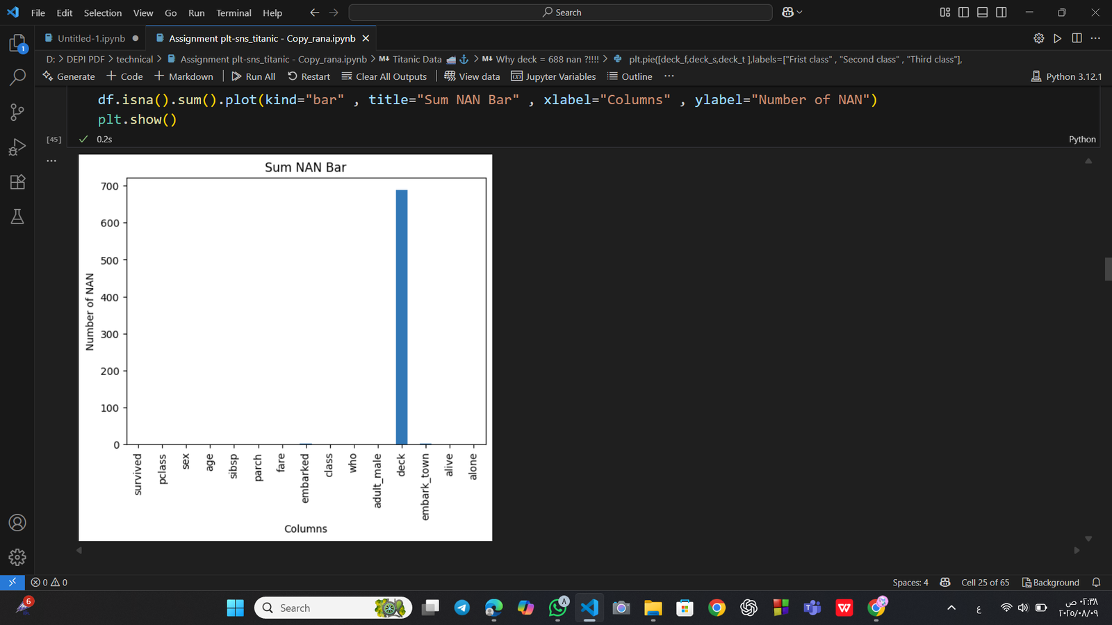
Data Cleaning and Preprocessing
Missing values in the Age column were filled with the mean age to maintain the distribution of the data.
Missing values in the Embarked and Embark_town columns were filled with the mode (most frequent value) since these are categorical variables.
This approach helps to keep the dataset complete and suitable for analysis while minimizing bias.
Most 1st-class passengers have deck info; very few 3rd-class passengers do

Slide 5
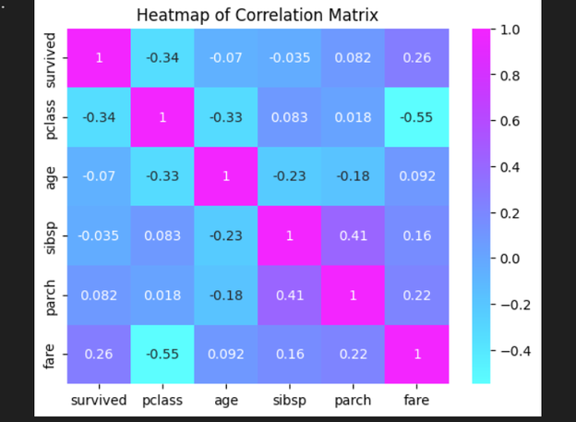
Key Insights
1
2
Fare vs Pclass:
Negative correlation between Fare and Pclass → first-class passengers tend to pay higher fares.
Survival vs Pclass: Negative correlation between Survived and Pclass → higher survival chances for first-class passengers

Slide 6
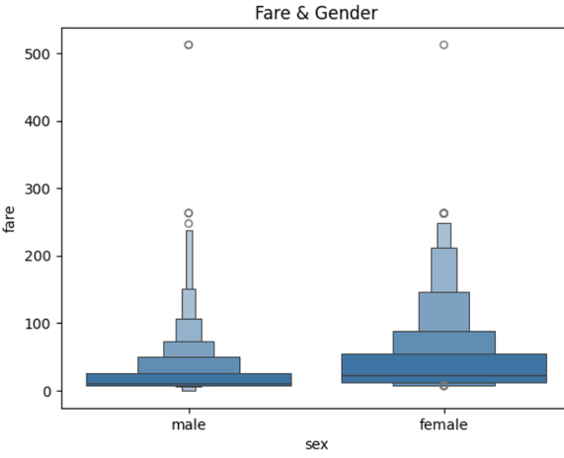
Key Insights
Fare Distribution:
Most passengers paid low ticket prices.
Female ticket fares are generally higher than male fares, with a higher median and wider overall price range.

Slide 7
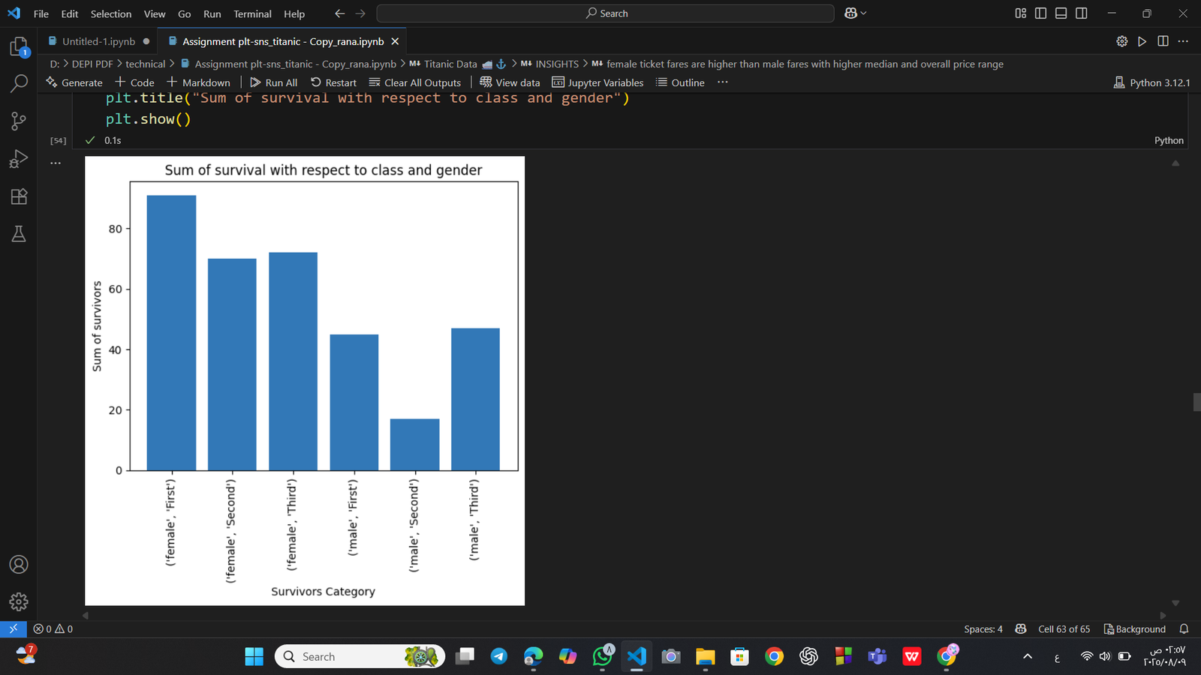
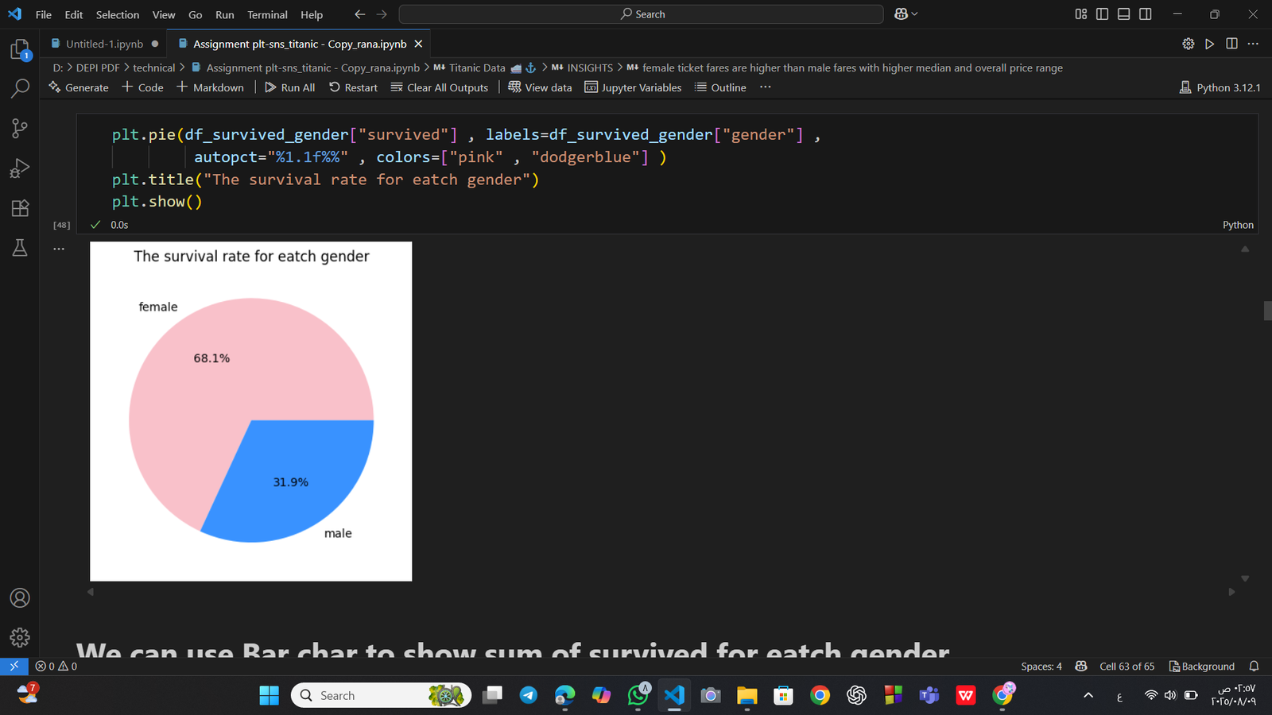
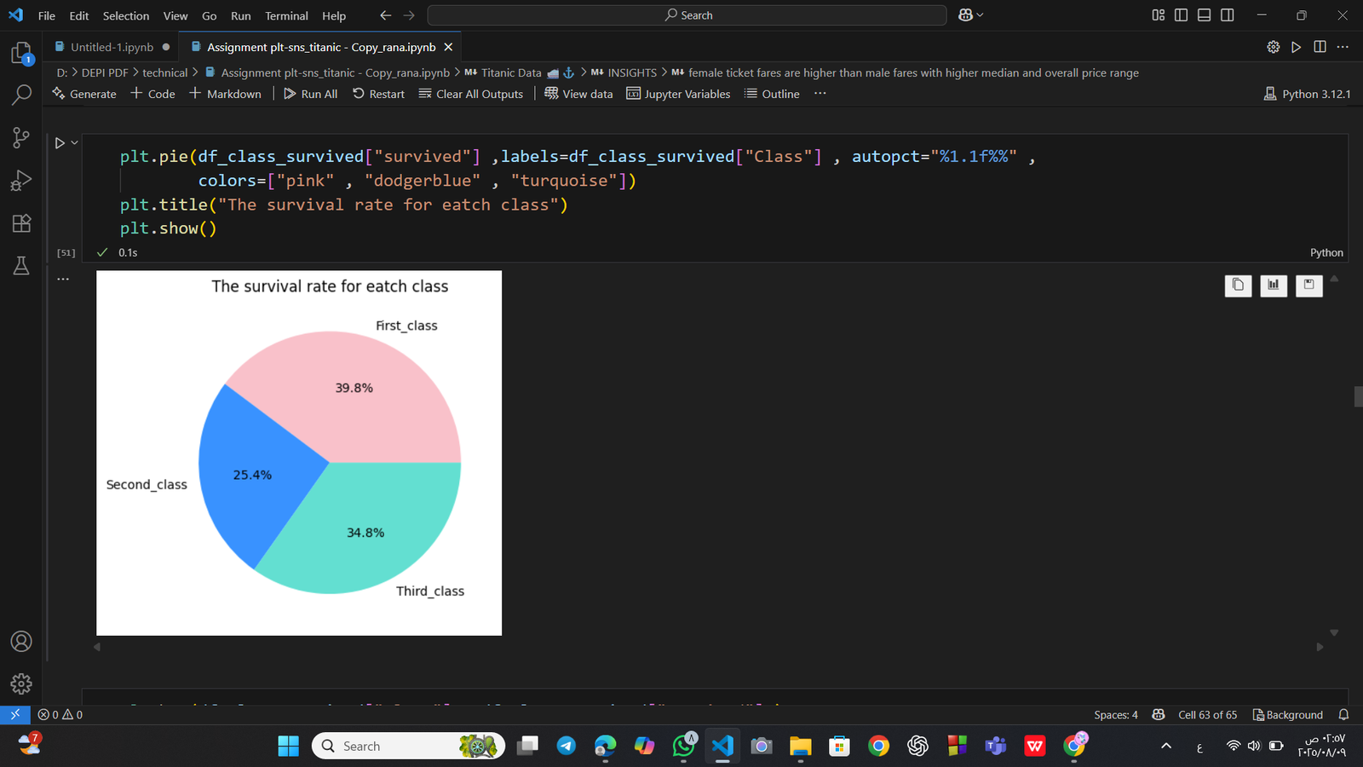
Key Insights
Gender and Survival:
Female survivors: 233 (68.1%)
Male survivors: 109 (31.9%)
Highest survival chance: Females in first class
Lowest survival chance: Males in second class
Survival Ranking:
By gender: 1. Females, 2. Males
By class: 1. First Class, 2. Second Class, 3. Third Class
Fare Distribution:

Slide 8
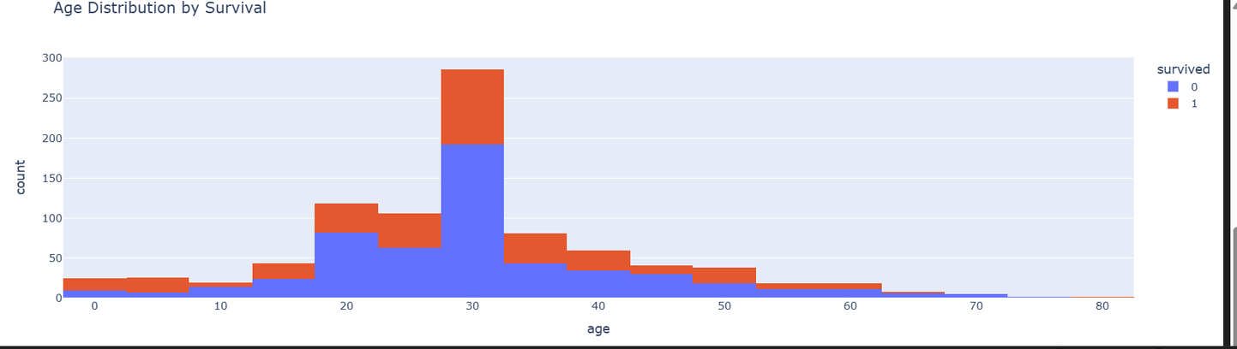
Key Insights
Age Distribution:
Most passengers were between 20 and 40 years old.

Slide 9
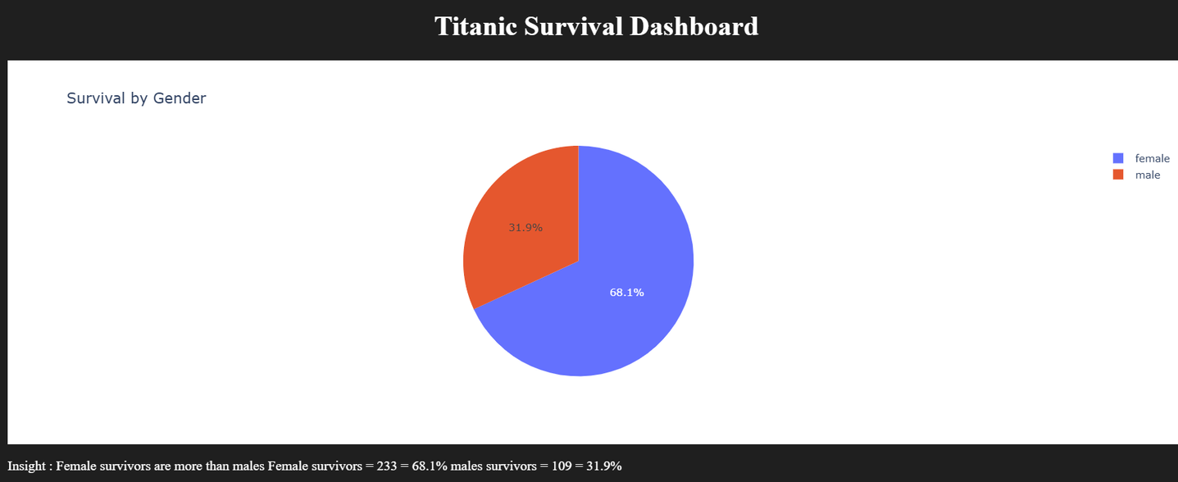

Slide 10
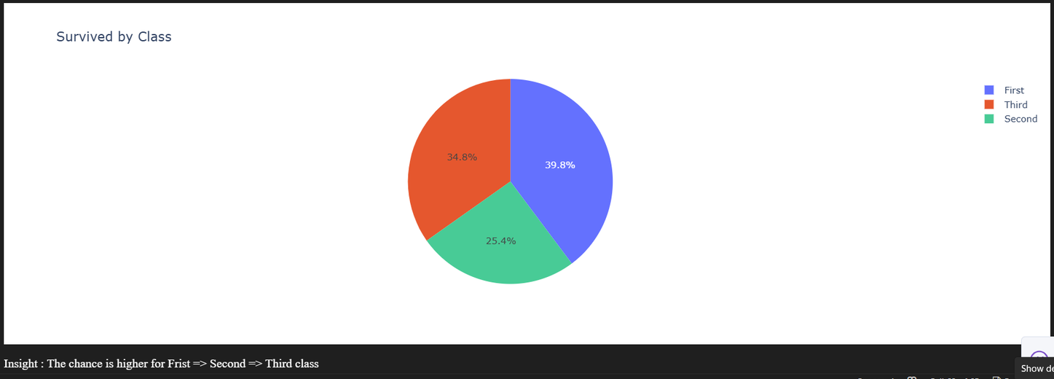

Slide 11
Thanks
Presented by : Rana Ahmed Elmaghraby

